Slide 1
Dimensinality Reduction

Slide 2
Curse of Dimension
Many Machine Learning problems involve thousands or even millions of features for each training instance.
Not only do all these features make training extremely slow, but they can also make it much harder to find a good solution
In real-world problems, it is often possible to reduce the number of features considerably

Slide 3
Benefits
Speeds up training
dimensionality reduction is also extremely useful for data visualization
However, causes some information loss

Slide 4
Two Approached
Projection
In most cases, all training instances lie within (or close to) a much lower-dimensional subspace of the high-dimensional space.
Manifold Learning
Many dimensionality reduction algorithms work by modeling the manifold
on which the training instances lie; this is called Manifold Learning.
A d-dimensional manifold is part of an n-dimensional space (where d < n) that resembles a d-dimensional hyperplane locally.

Slide 5
Projection

Slide 6
Swiss Roll

Slide 7
PCA
First PCA identifies the hyperplane that lies closest to the data
Then it projects the data onto that hyperplane
Maximizes Variance along Principle components

Slide 8
Singular Value Decomposition
So how can you find the principal components of a training set?
Luckily, there is a standard matrix factorization technique called Singular Value Decomposition (SVD) that can decompose the training set matrix X into the matrix multiplication of three matrices U Σ VT
PCA assumes that the dataset is centered around the origin.

Slide 9
PCA with Scikit Learn
from sklearn.decomposition import PCA
pca = PCA(n_components=2)
X2D = pca.fit_transform(X)
pca.explained_variance_ratio_
array([0.7578477 , 0.15186921])
This output tells you that about 76% of the dataset’s variance lies along the first PC, and about 15% lies along the second PC.

Slide 11
Choosing the right # of dimensions

Slide 12
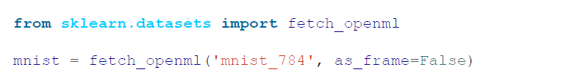
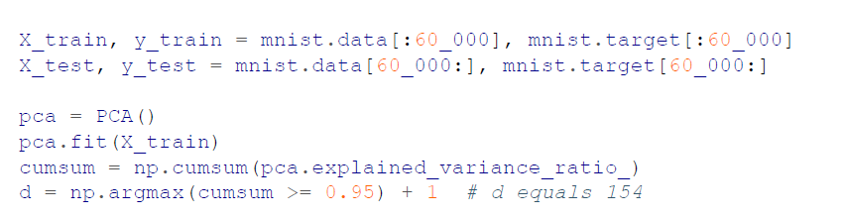
Choosing the right # of dimensions with preserving variance upto certain percent

Slide 13

pca = PCA(n_components=0.95)
X_reduced = pca.fit_transform(X_train)

Slide 14
Choosing the right # of dimensions by looking at the ploy of explained varience

Slide 15
Choosing the right # of dimensions by tuning Hyperparameters
Code on the next slide
print(rnd_search.best_params_)
{
'randomforestclassifier__n_estimators': 465,
'pca__n_components': 23
}

Slide 16
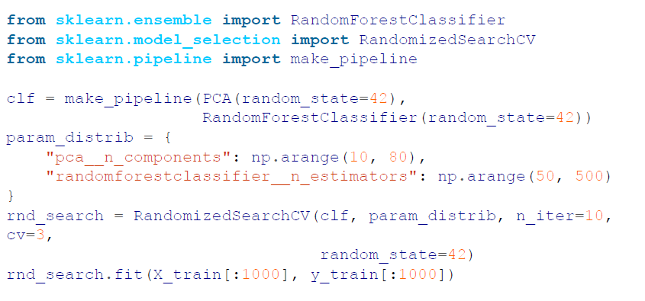

Slide 17
PCA for Compression
For example, after applying PCA to the MNIST dataset while preserving 95% of its variance.
We are left with 154 features, instead of the original 784 features.
The dataset is now less than 20% of its original size, and we only lost 5% of its variance!
It is also possible to decompress the reduced dataset back to 784 dimensions by applying the inverse transformation of the PCA projection.
X_recovered = pca.inverse_transform(X_reduced)

Slide 19
Randomized PCA
Randomized PCA works by randomly sampling a subset of the data and then using this subset to estimate the principal components of the full dataset. This is a much faster and more efficient way to compute the principal components than using the full dataset, and it is also less likely to overfit the data.

Slide 20
IncrementalPCA
Allows you to split the training set into mini-batches and feed an IPCA algorithm one mini-batch at a time.
This is useful for large training sets and for applying PCA online

Slide 21
Random Projection
Random Projection algorithm projects the data to a lower-dimensional space using a random linear projection.
This may sound crazy, but it turns out that such a random projection is actually very likely to preserve distances fairly well
from sklearn.random_projection import GaussianRandomProjection
Or SparseRandomProjection.

Slide 22
Benefits of using sparse Matrix
It uses much less memory: about 25 MB instead of almost 1.2GB for a dataset of 5000 instances with 20_000 features!
It is much faster, about 50% faster for the above dataset.
The ratio r of nonzero items in the sparse random matrix is called its
density.
By default, it is equal to 1/√n. With 20,000 features, this means that only one in ~141 cells in the random matrix is nonzero: that’s quite sparse!

Slide 23
Linear Discriminant Analysis (LDA)
Linear Discriminant Analysis (LDA) is a linear classification algorithm, and during training it learns the most discriminative axes between the classes.
These axes can then be used to define a hyperplane onto which to project the data.
The benefit of this approach is that the projection will keep classes as far apart as possible
Use LDA to reduce dimensionality before running another classification algorithm (unless LDA is sufficient).

Slide 24
t-Distributed Stochastic Neighbor Embedding (t-SNE)
Reduces dimensionality while trying to keep similar instances close and dissimilar instances apart.
It is mostly used for visualization, in particular, to visualize clusters of instances in high-dimensional space.
sklearn.manifold.TSNE

Slide 25
Exercise
Load the MNIST dataset (introduced in Chapter 3) and split it into a training set and a test set (take the first 60,000 instances for training, and the remaining 10,000 for testing). Train a Random Forest classifier on the dataset and time how long it takes, then evaluate the resulting model on the test set. Next, use PCA to reduce the dataset’s dimensionality, with an explained variance ratio of 95%. Train a new Random Forest classifier on the reduced dataset and see how long it takes. Was training much faster?
Try again with an SGDClassifier. How much does PCA help now?

Slide 26
Exercise
Use t-SNE to reduce the first 5,000 images of the MNIST dataset down to two dimensions and plot the result using Matplotlib.
Try using other dimensionality reduction algorithms and compare the resulting visualizations.

